Slide 1
Facial and Object
Recognition
Final Year Project 2018-2019
End Sem Assessment
Ankita Gonnade BT15CSE028
Shruti Nashine BT15CSE055
Under the guidance of
Dr. Praveen Kumar

Slide 2
Face Recognition
OpenCV, Python with deep learning
Libraries used: 1)dlib 2)face_recognition
3)imultis
The dlib library is used to construct our face embeddings used for the actual recognition process.
The face_recognition library, wraps around dlib’s facial recognition functionality, making it easier to work with.
The imultis library is used to make basic image processing functions such as translation, rotation, resizing, skeletonization, displaying Matplotlib images, sorting contours, detecting edges, and much more easier with OpenCV and both Python.
Notes:
For the dlib facial recognition network, the output feature vector is 128-d (i.e., a list of 128 real-valued numbers) that is used to quantify the face. Training the network is done using triplets:
Here we provide three images to the network:
Two of these images are example faces of the same person.
The third image is a random face from our dataset and is not the same person as the other two images.
As an example, let’s again consider Figure 1 above where we provided three images: one of Chad Smith and two of Will Ferrell.
Our network quantifies the faces, constructing the 128-d embedding (quantification) for each.
From there, the general idea is that we’ll tweak the weights of our neural network so that the 128-d measurements of the two Will Ferrel will be closer to each other and farther from the measurements for Chad Smith.

Slide 3
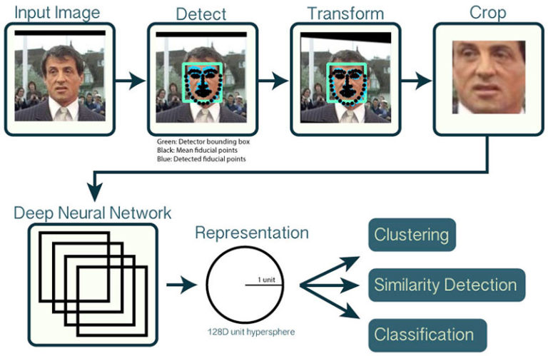
Implementation Steps
Create dataset.
required for training the network (larger the dataset
more accurate the training)
Detect faces in dataset : hog or cnn .
Detection of the presence and location of a face
in an image, but does not identify it
Compute 128-d face embeddings to quantify a face.
Recognize faces in images and video streams by matching with the trained dataset.
Notes:
Before we can encode faces in images we first need to detect them. Or two face detection methods include either hogor cnn .
The CNN method is more accurate but slower. HOG is faster but less accurate.

Slide 4
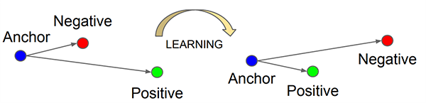
Process of deep learning
The anchor and positive image both
belong to the same person/face
while the negative image does not
contain the same face.
The neural network computes the
128-d embeddings for each face and then tweaks the weights of the network (via the triplet loss function) such that:
The 128-d embeddings of the anchor and positive image lie closer together
While at the same time, pushing the embeddings for the negative image father away
In this manner, the network is able to learn to quantify faces and return highly robust and discriminating embeddings suitable for face recognition.
Notes:
To train a face recognition model with deep learning, each input batch of data includes three images:
The anchor
The positive image
The negative image
The anchor is our current face and has identity A.
The second image is our positive image — this image also contains a face of person A.
The negative image, on the other hand, does not have the same identity, and could belong to person B, C, or even Y!
The point is that the anchor and positive image both belong to the same person/face while the negative image does not contain the same face.
The neural network computes the 128-d embeddings for each face and then tweaks the weights of the network (via the triplet loss function) such that:
The 128-d embeddings of the anchor and positive image lie closer together
While at the same time, pushing the embeddings for the negative image father away
In this manner, the network is able to learn to quantify faces and return highly robust and discriminating embeddings suitable for face recognition.

Slide 5
Recognizing faces from video stream
To access our camera we’re using the VideoStream class from imutils.
Then we have to grab a frame from the video stream.
We read the frame , preprocess, then detect face bounding boxes and calculate encodings for each bounding box.
After detecting face in the frame, the compare_faces function is computing the Euclidean distance between the candidate embedding and all faces in our dataset:
If the distance is below some tolerance (the smaller the tolerance, the more strict our facial recognition system will be) then we return True , indicating the faces match.
Otherwise, if the distance is above the tolerance threshold we return False as the faces do not match.
Given our matches list we can compute the number of “votes” for each name (number of True values associated with each name), tally up the votes, and select the person’s name with the most corresponding votes.

Slide 6
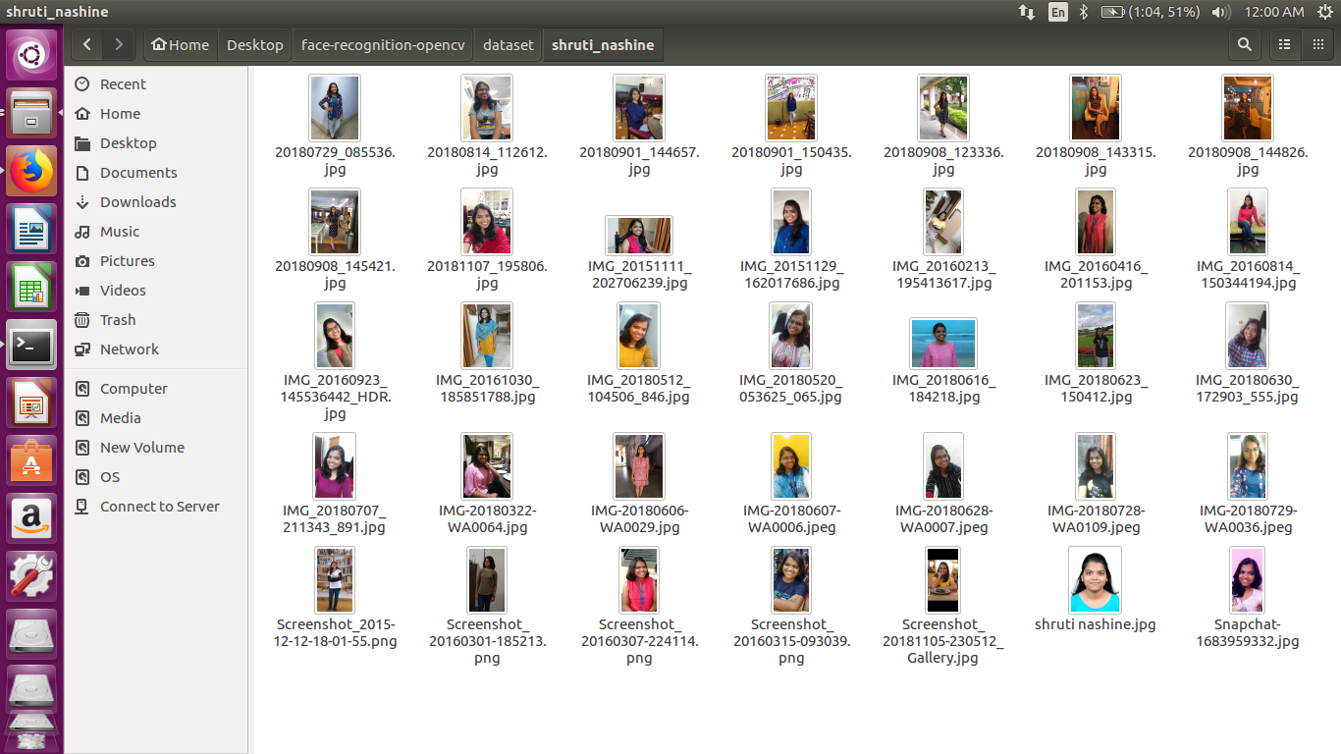
Here’s one of the datasets that we created for training.

Slide 7
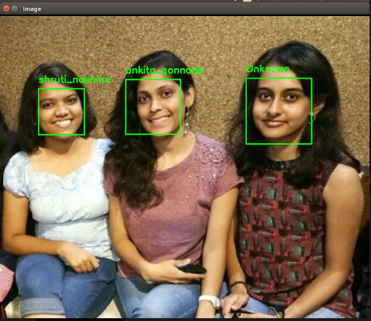
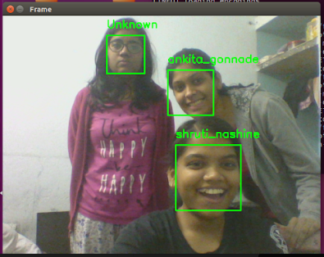
Output with names on a image
Recognized faces in a live streaming video

Slide 8
Summary
What we achieved have so far
Training of datasets with the input images
Detection of face
Recognition of face in real time streaming
Next Course of action
Adding the unknown datasets in real time streaming.
Integrate this whole structure with the a compatible device
Start working on our next part, that is Object Recognition

Slide 9
Thank you!

